Slide 1
CIS 11 – Computer Architecture
James Wilson

Slide 2
Discrete Math: Truth Tables
X | Y | AND | OR | NOT | XOR
0 | 0 | 0 | 0 | 1,1 | 0
0 | 1 | 0 | 1 | 1,0 | 1
1 | 0 | 0 | 1 | 0,1 | 1
1 | 1 | 1 | 1 | 0,0 | 0

Slide 3
Logical Operators: AND
Performs a bit-wise AND on two operands
reg,reg
reg,mem
reg,imm
mem,reg
mem,imm
.data
array BYTE 50 DUP(?)
.code
mov ecx,LENGTHOF array
mov esi,OFFSET array
L1:
and BYTE PTR [esi],11011111b ; clear bit 5
inc esi
loop L1

Slide 4
Logical Operators: OR
Performs a bit-wise OR on two operands
reg,reg
reg,mem
reg,imm
mem,reg
mem,imm

Slide 5
Logical Operators: XOR
Performs a bit-wise OR on two operands
reg,reg
reg,mem
reg,imm
mem,reg
mem,imm

Slide 6
Logical Operators: NOT
Performs a bit-wise NOT on an operand
reg
mem
Essentially toggles each bit in an operand

Slide 7
Conditional Branching
CMP
Implied subtraction between two operands
Results are discovered by checking various flag registers
IF statements
We now have the basic tools we need to implement conditional branching (if statements)
What are they?

Slide 8
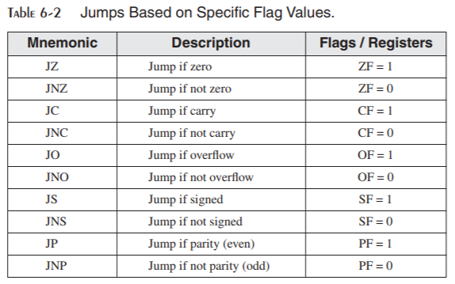
Conditional Branching
JCOND
Conditional jump
Jumps to a location if certain status flag conditions are true

Slide 9
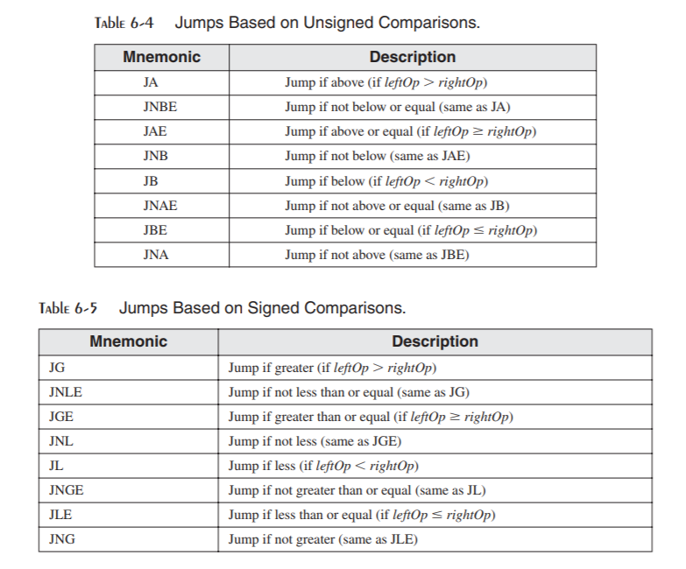
Conditional Branching
Equality checks

Slide 10
Example 1
mov edx,-1
cmp edx,0
jnl L5 ; jump not taken (-1 >= 0 is false)
jnle L5 ; jump not taken (-1 > 0 is false)
jl L1 ; jump is taken (-1 < 0 is true)

Slide 11
Example 2
mov bx,+32
cmp bx,-35
jng L5 ; jump not taken (+32 <= -35 is false)
jnge L5 ; jump not taken (+32 < -35 is false)
jge L1 ; jump is taken (+32 >= -35 is true)

Slide 12
Example 3
mov al,+127 ; hexadecimal value is 7Fh
cmp al,-128 ; hexadecimal value is 80h
ja IsAbove ; ??
jg IsGreater ; ??

Slide 13
Additional Concepts
Nested conditions
Short Circuiting
While loops
Book example page 212-213
White Box Testing
Control flow Directives

